Slide 1
Final Mini Project Demonstration
UE18CS257F
Project Title : Energy efficiency for HDFS
Project ID : MPW20HLP03
Project Guide : Prof. H L Phalachandra
Project Team :
Abhishek Das (PES1201800177)
N Sanketh Reddy (PES1201800389)
Bhargav SNV (PES1201800308)

Slide 2
Project Abstract and Scope
In our project, we propose a more dynamic approach to Hadoop Distributed File Systems (HDFS) that provides an energy efficient paradigm for clusters using HDFS.
The project does not involve working on the actual Hadoop codebase. Instead, we work with a simulator which handles the default policies of HDFS and accurately simulates its functioning.

Slide 3
Design Approach
Design approach followed
We implemented a custom zone layout over Hadoop clusters. The cluster was split into two zones, the Hot zone and the Cold Zone.
To set up our working environment, we set up a simulator to handle the functioning of HDFS.
Benefits and drawbacks
The use of a simulator helped us avoid physical hardware setup. This type of real world setup would be infeasible.
However, the simulator does not take into account real world issues.

Slide 4
Design Constraints, Assumptions & Dependencies
Constraints
The original simulator could not measure energy consumption. Hence, additional modules to measure power were setup.
Assumptions
The values assigned to power consuming events in the simulator are assumed to be close to real world values.
The design of the custom zone layout is based on the properties of the memory storage devices i.e. SSDs and HDDs.

Slide 5
Design Description

Slide 6
New/Modified Policies
A new block placement policy and heartbeat mechanism have been devised.
Blocks are placed strategically in an energy efficient manner. Nodes that are not active (Cold nodes) are put to sleep and hence do not have a heartbeat like the other active nodes.
Dynamic data storage/transfer mechanism between hot and cold zones using a transition script.
As and when data turns cold/hot, the blocks are transferred across zones.
Customized block balancers for each zone.
Custom block balancers work on each zone to keep data fault tolerant and strategically placed

Slide 7
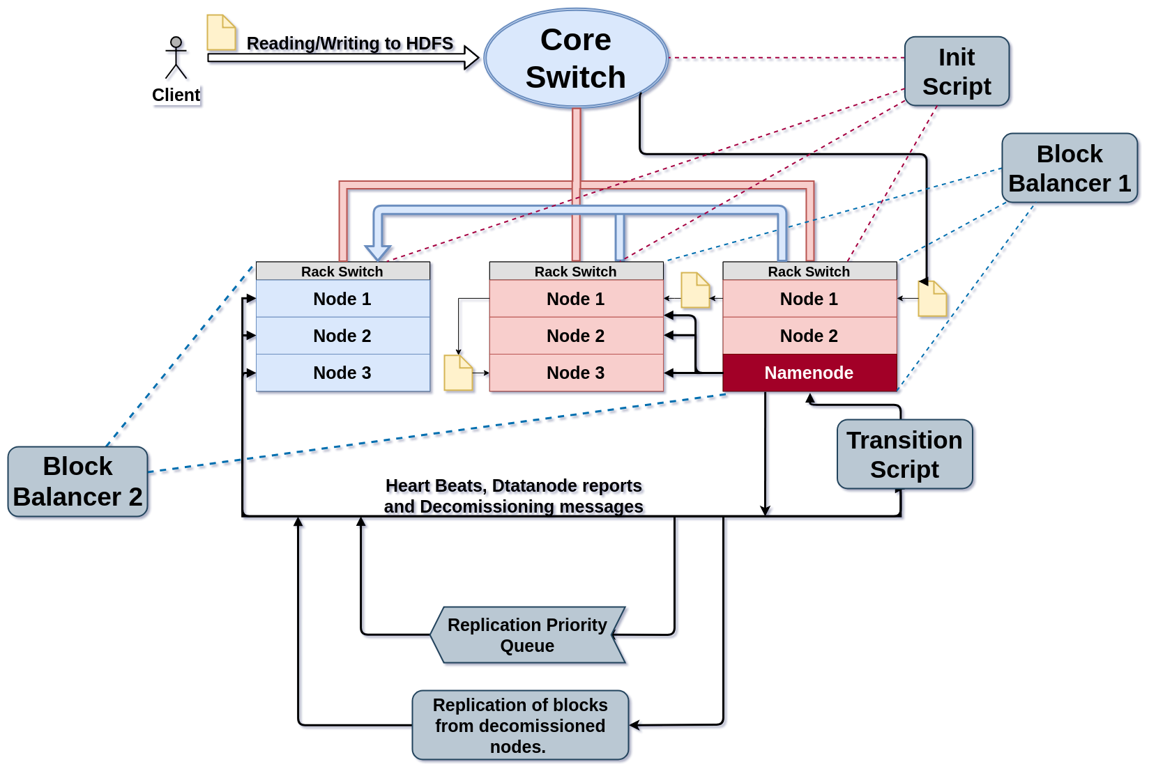

Custom Zone Layout

Slide 8
Algorithm
Cluster and Zone creation
The cluster is brought into an active state and Hot, Cold Zones are created.
The percentage of Hot Zone is pre determined based off the number of nodes with SSDs as a storage device.
Initial Block Distribution
New data on entering the cluster is distributed among the hot nodes.
These blocks are placed such that minimum number of nodes are used to store maximum number of blocks along with replicas.

Slide 9
Algorithm
Block Transfer
As blocks in the hot zone are unused over time, they turn cold.
The transition script recognises cold blocks and moves them to the cold zone. Likewise, if a cold block is accessed frequently, it is moved to the hot zone.
Block Balancing
As blocks are transferred between zones, they need to be replicated. The hot and cold zone have different replication factors. Usually with the cold zone having 2/3rd the value of hot zone.
To accommodate different replication factors in zones, different block balancers are employed.

Slide 10
Custom Zone Layout

Slide 11
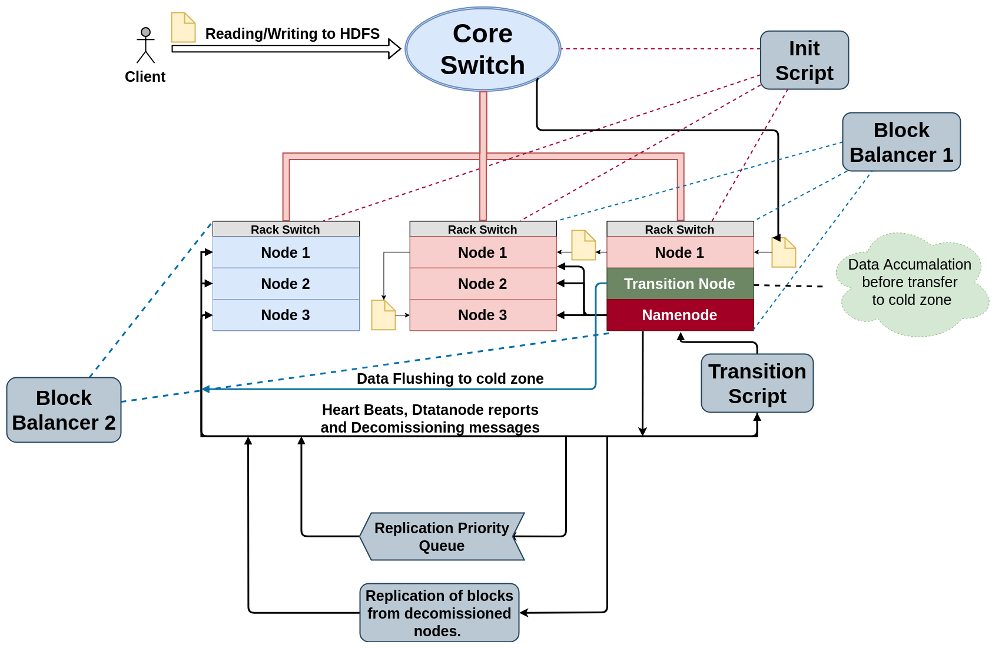
Alternate Algorithm

Slide 12
Technologies Used
HDFS replication simulator
IntelliJ IDEA, Java
Apache Hadoop
Vagrant, Virtual Box
Draw.io
Notes:
12

Slide 13
Project Demo

Slide 14
Evaluation Results

Slide 15
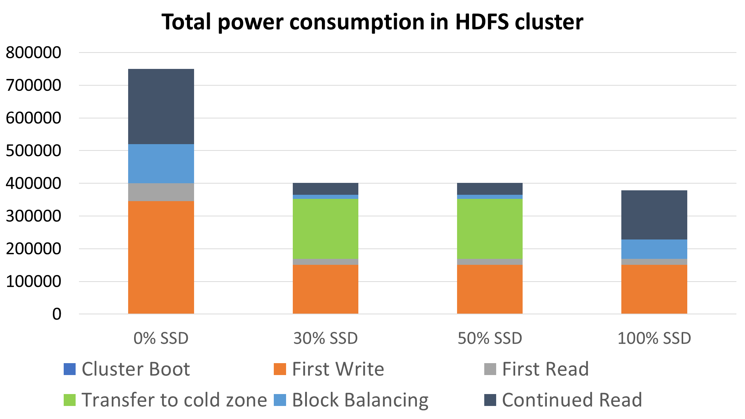
Energy consumed in a single life cycle
Notes:
15

Slide 16
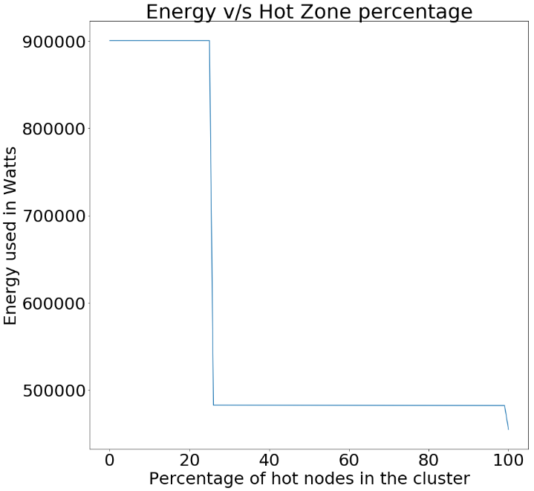
Energy v/s Hot Zone Percentage
The graph shows how the total energy consumed varies when we vary the Hot-Zone percentage in the cluster.
Here there is a sudden drop in the energy consumption at around, Hot Zone % = 30 because, a minimum of about 30% of the cluster must belong to the hot zone to handle peak workloads, else it defaults to the default Hadoop configuration (no hot/cold zone).
The second dip at HZ% 100 is because there are no HDDs in the cluster, this indicates that all the nodes in the cluster make use of SSDs, thus saving a significant amount of energy
Notes:
16

Slide 17
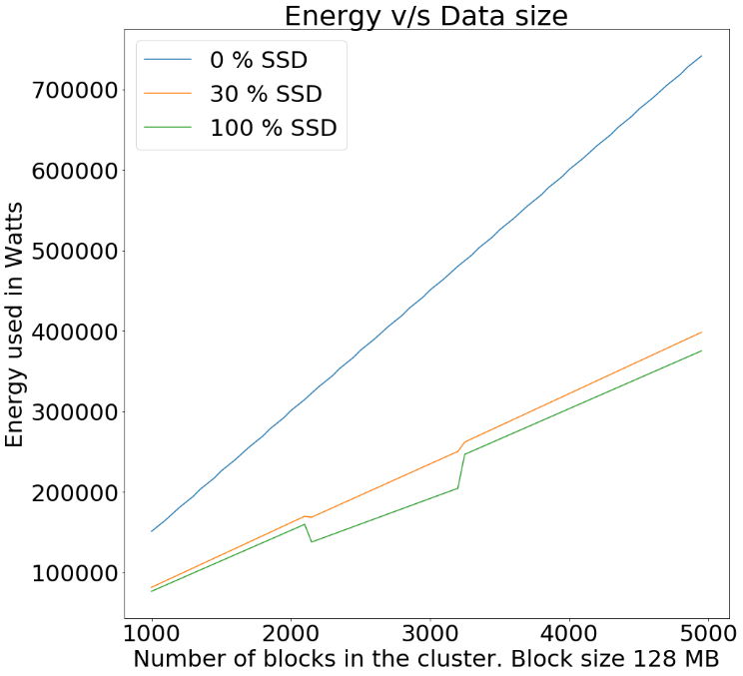
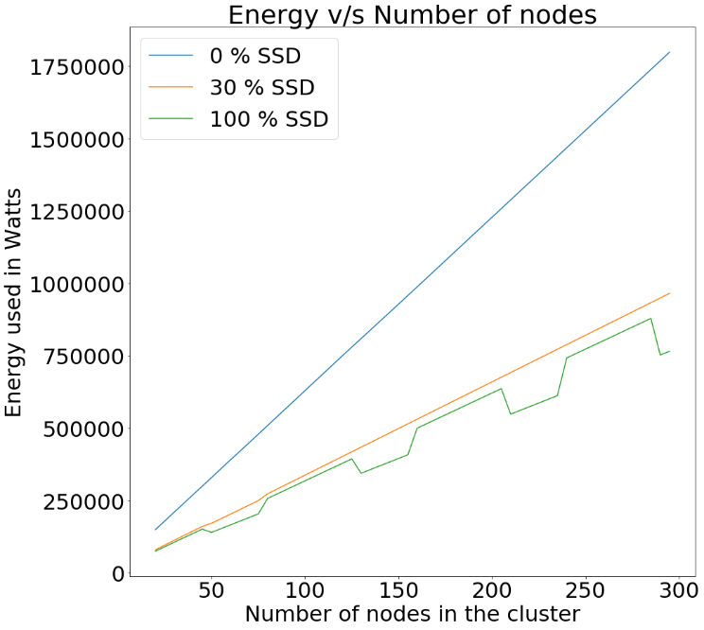
Scalability of Algorithm
Notes:
17

Slide 18
Thank You

